Slide 1
COMP30810 Intro to Text Analytics
Dr. Binh Thanh Le
thanhbinh.le@ucd.ie
Insight Centre for Data Analytics
School of Computer Science
University College Dublin

Slide 2
Today Goals:
Understanding the main concept of clustering
Understanding several classifiers: K-Means Clustering, Hierarchical Clustering
Applying the classifiers to Text Mining

Slide 3
Recap: Text → Vector
Represent an item as a vector of numbers
 | banana | tree | fruit | grow | yellow
Document1 | 3 | 1 | 1 | 1 | 1
Document 2 | 0 | 1 | 0 | 1 | 0
By counting
vector
 | banana | tree | fruit | grow | yellow
Document1 | 0.24 | 0.12 | 1.35 | 0.7 | 2.5
Document 2 | 0 | 0.15 | 0 | 0.11 | 0
By tf-idf

Slide 4
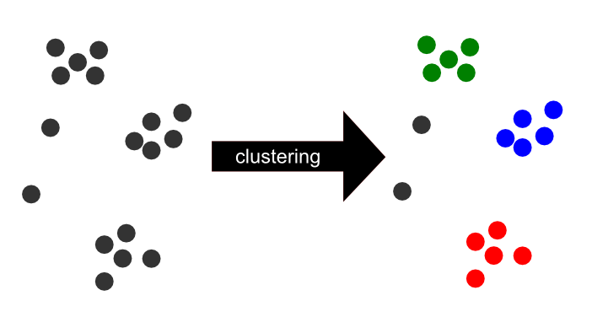
Represent in 2-D dimensional space
d12
d4
d1

Slide 5
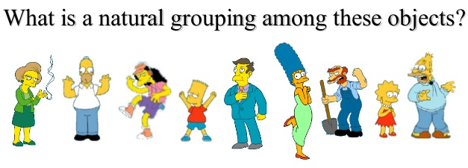
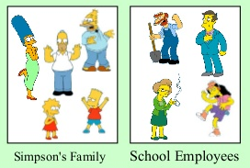
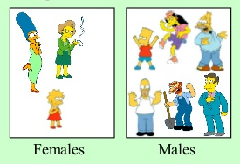
1) What is clustering?
Clustering is unsupervised technique to split the samples into several groups (clusters):
Samples in same cluster are similar
Samples in different clusters are dissimilar
or

Slide 6
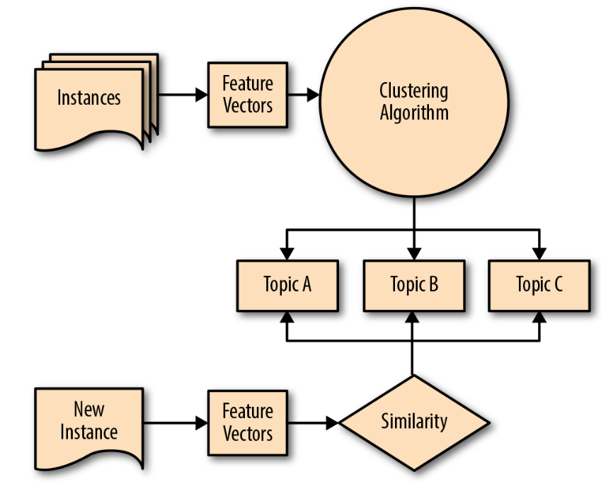
Clustering pipeline

Slide 7
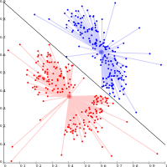
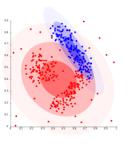

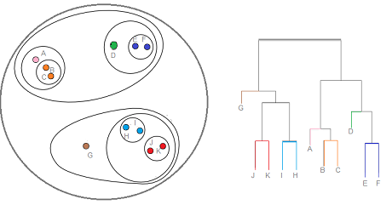
1.2)Categorize clustering algorithms
Clustering algorithm can be categorized into:
Centroid-based clustering
Distribution-based clustering
Density-based clustering
Connectivity-based clustering (hierarchical clustering)
Find the k cluster centers and assign the objects to the nearest cluster center
Clusters can then easily be defined as objects belonging most likely to the same distribution
Clusters are defined as areas of higher density than the remainder of the data set.
Is based on the core idea of objects being more related to nearby objects than to objects farther away

Slide 8
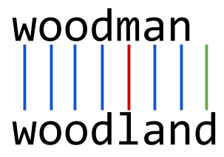
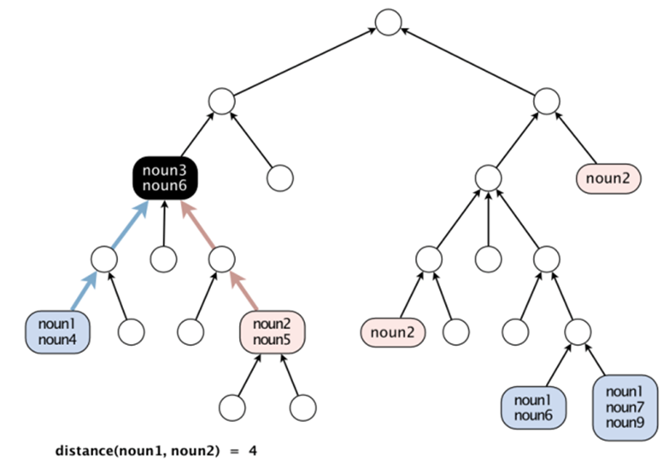
Recap: Distance Measurements
Levenshtein Distance
Blogs, tweets, comments, …
WORDNET - Distance
< Meaning >

Slide 9
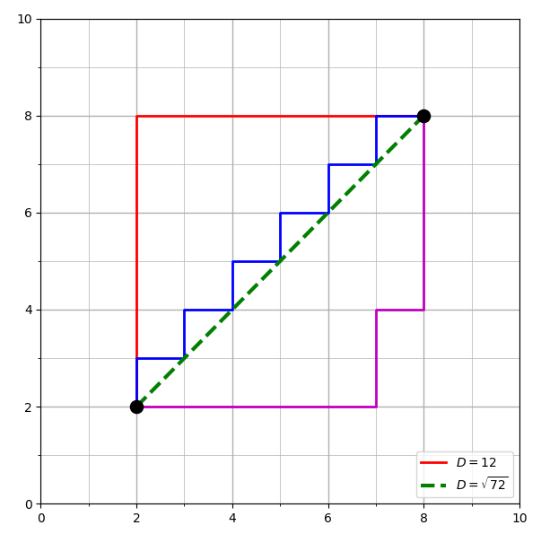
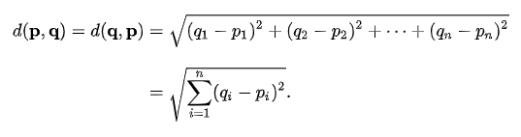
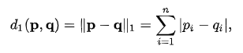
Recap: Distance Measurements
Euclidean Distance
Doc2
Manhattan Distance
Doc1

Slide 10
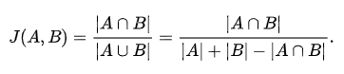
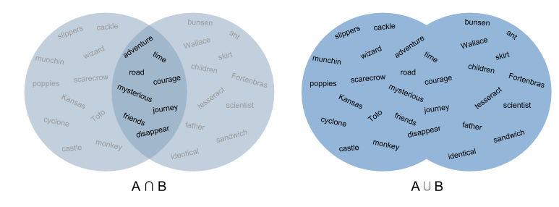
Recap: Distance Measurements
Jaccard Similarity

Slide 11
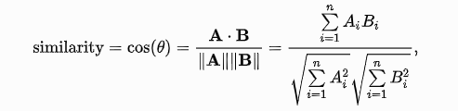
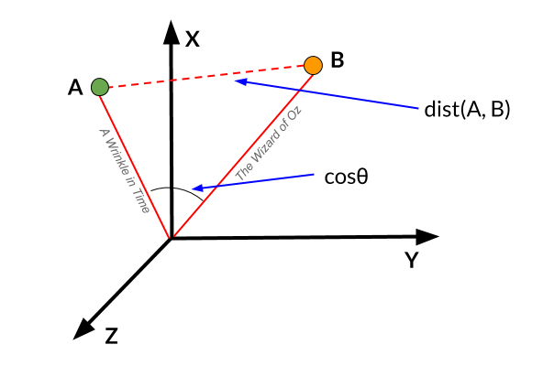
Recap: Distance Measurements
Cosine Similarity
Cosine Distance
Distance = 1 - Similarity

Slide 12
2) K-Means clustering: distance based method
Centroid-based clustering
K-Means clustering intends to partition n objects (documents) into k clusters (groups) in which each object belongs to the cluster with the nearest mean.
Output:
Cluster A , Cluster B, Cluster C
(centroid A, centroid B, centroid C)
K-mean
centroid
centroid
centroid

Slide 13
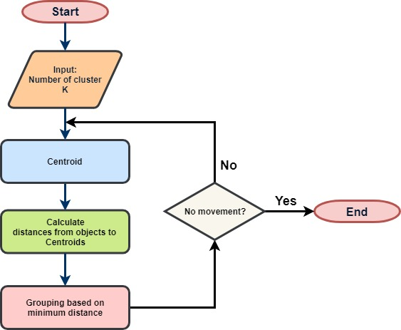
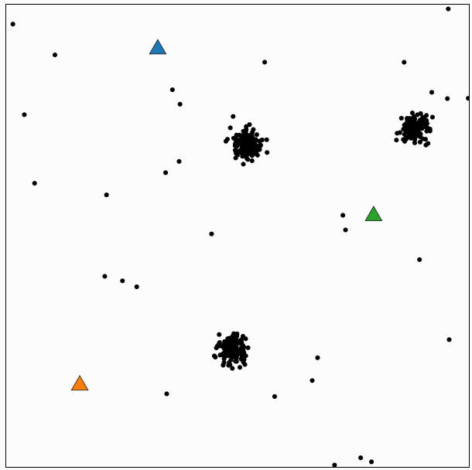
2) K-Means clustering: distance based method
Demo
Centroid
Centroid
Centroid
Init: 3 clusters, and 3 centroids (random)

Slide 14
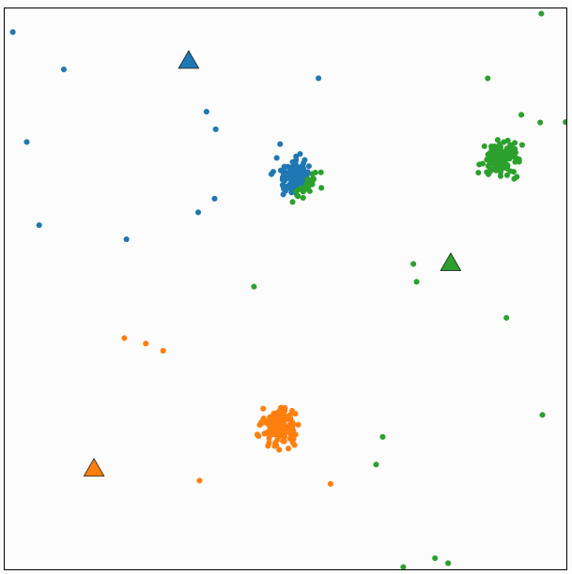
2) K-Means clustering: distance based method
Demo
Centroid
Centroid
Centroid
Calculate distances; Group samples

Slide 15
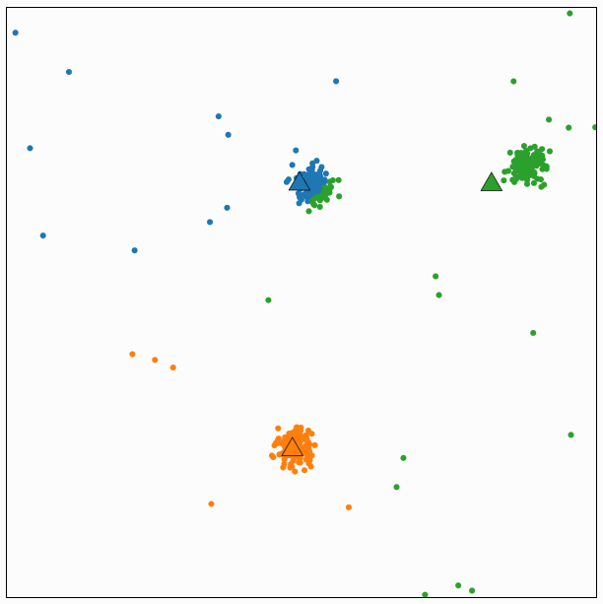
2) K-Means clustering: distance based method
Demo
Centroid
Centroid
Centroid
Iteration 2: Compute Centroids

Slide 16
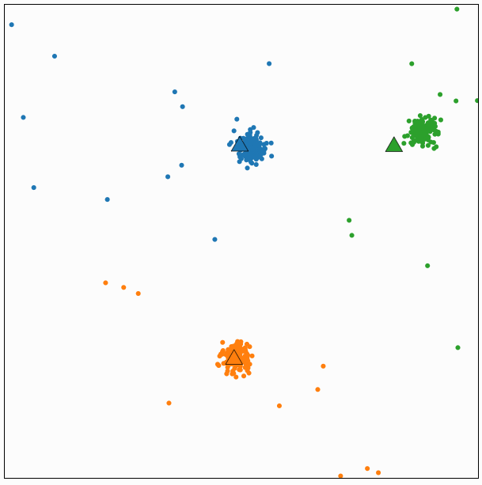
2) K-Means clustering: distance based method
Demo
Centroid
Centroid
Centroid
Calculate distances; Group samples

Slide 17
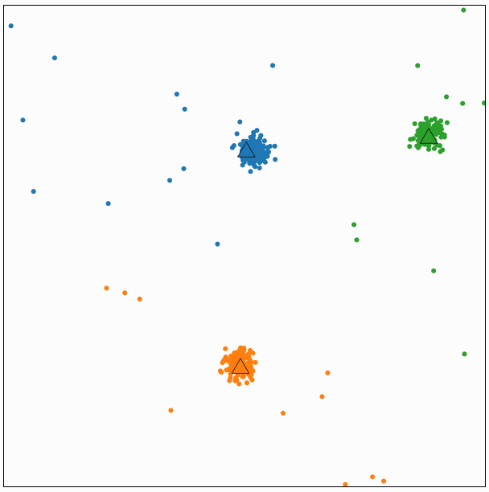
2) K-Means clustering: distance based method
Demo
Centroid
Centroid
Centroid
Iteration 3: Compute Centroids
➔ No sample move → End

Slide 18
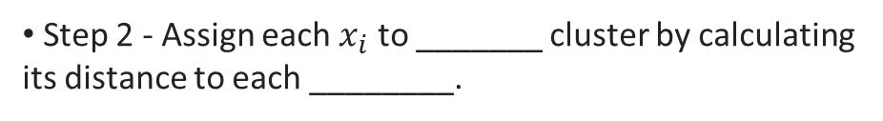
Pseudo-code for K-mean Clustering
Tasks: Filling the blank with appropriate words
Step 1 - Pick K _____ points as cluster centers called ________.
Step 2 - Assign each $x_{i}$​ to _______ cluster by calculating its distance to each ________.
Step 3 - Find new _________ by taking the _______ of the assigned points.
Step 4 - Repeat Step 2 and 3 until _________________.

Slide 19
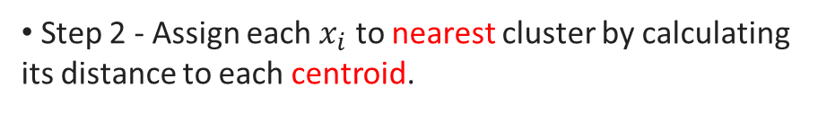
Pseudo-code for K-mean Clustering
Step 1 - Pick K random points as cluster centers called centroids.
Step 2 - Assign each $x_{i}$​ to nearest cluster by calculating its distance to each centroid.
Step 3 - Find new centroids by taking the mean of the assigned points.
Step 4 - Repeat Step 2 and 3 until none of the cluster assignments change.

Slide 20
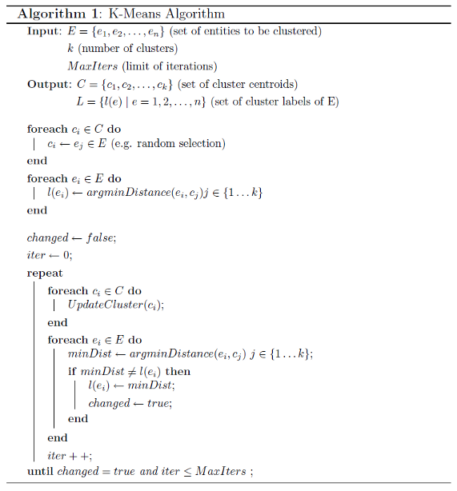
Pseudo-code for K-mean Clustering

Slide 21
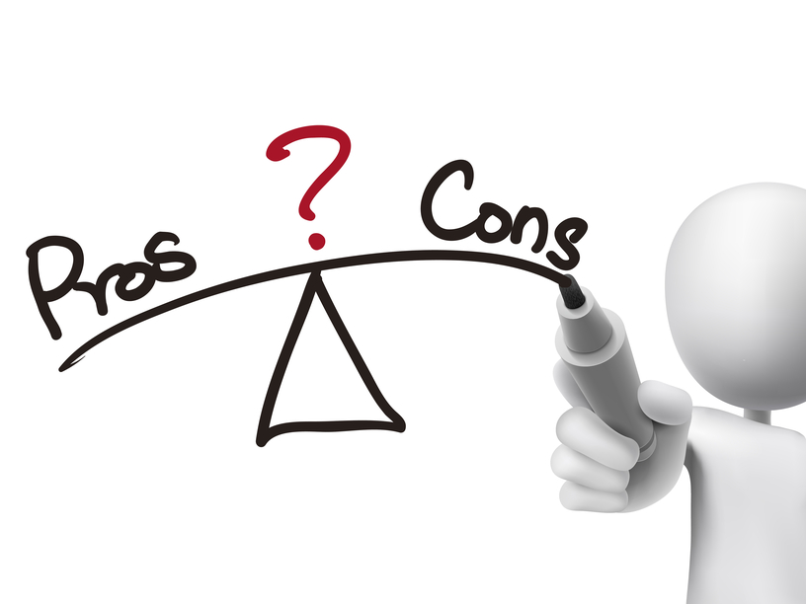
2.1) Pros and Cons of K-means clustering
Pros:
Easy to implement
With a large number of variables, K-Means may be computationally faster than hierarchical clustering (if K is small).
An instance can change cluster (move to another cluster) when the centroids are recomputed
Cons
Difficult to predict the number of clusters (K-Value)
Initial centroids have a strong impact on the final results
Depends on distance measurement → change distance computation will change the final results

Slide 22
2.2) How to choose K?
We often know the value of K. In that case we use the value of K.
Else, we use several techniques to find the K:
Elbow method
Cross-validation
Average silhouette method
Gap statistic method
Information criterion approaches: Akaike information criterion (AIC), Bayesian information criterion (BIC), Deviance information criterion (DIC)
Rate–distortion theory

Slide 23
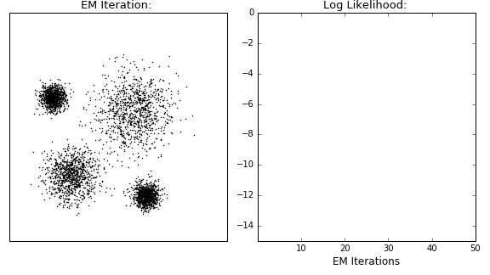
Distribution-based clustering
Expectation Maximization

Slide 24
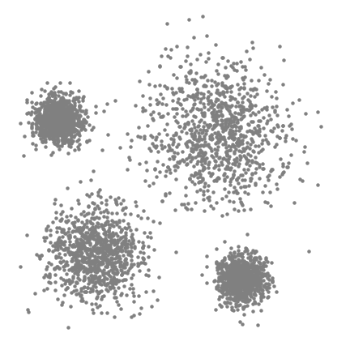
Density-based clustering
Mean-Shift Clustering

Slide 25
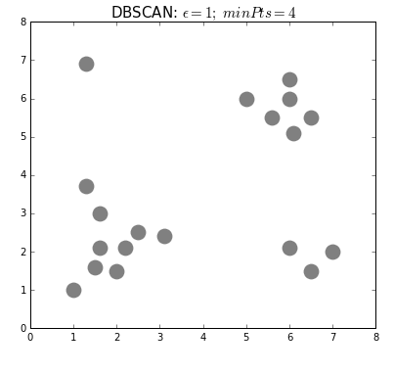

Density-based clustering
Density-Based Spatial Clustering of Applications with Noise (DBSCAN)

Slide 26

3) Hierarchical Clustering
Demonstration

Slide 27
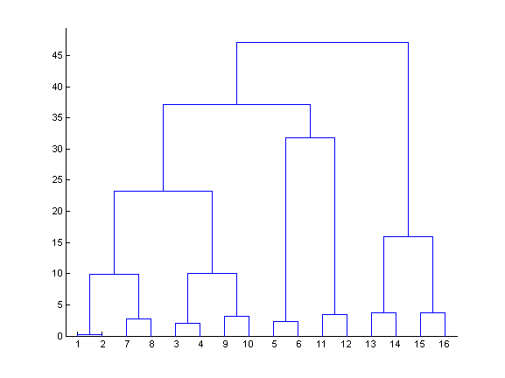
3) Hierarchical Clustering
Connectivity-based clustering
We start with every data point in a separate cluster
We keep merging the most similar pairs of data points/clusters until we have one big cluster left
This is called a bottom-up or agglomerative method
This produces a binary tree or dendrogram
The final cluster is the root and each data item is a leaf
The height of the bars indicate how close the items are

Slide 28
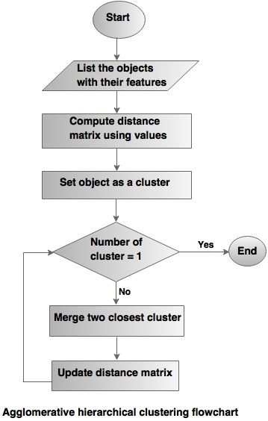
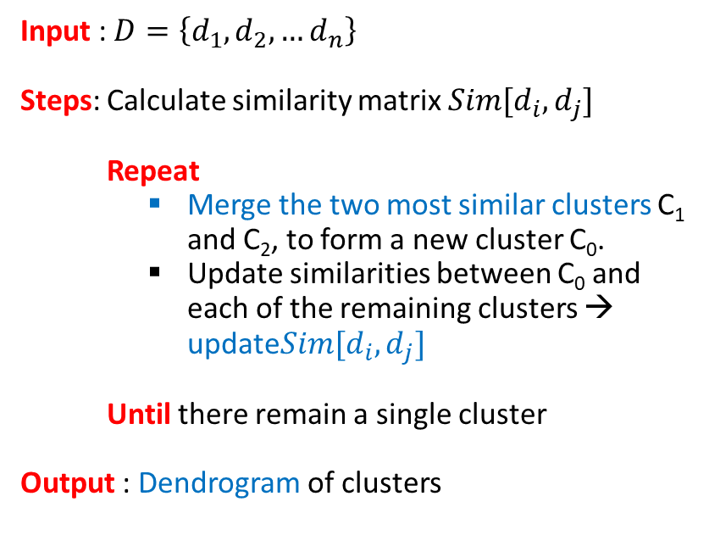
3) Hierarchical Clustering Flowchart
Input : $D=\left\{d_{1},d_{2},…d_{n}\right\}$
Steps: Calculate similarity matrix $Sim[d_{i},d_{j}]$
Repeat
Merge the two most similar clusters C₁ and C₂, to form a new cluster C₀.
Update similarities between C₀ and each of the remaining clusters → update$Sim[d_{i},d_{j}]$
Until there remain a single cluster
Output : Dendrogram of clusters

Slide 29
3) Hierarchical Clustering Flowchart
Input : $D=\left\{d_{1},d_{2},…d_{n}\right\}$
Steps: Calculate similarity matrix $Sim[d_{i},d_{j}]$
Repeat
Merge the two most similar clusters C₁ and C₂, to form a new cluster C₀.
Update similarities between C₀ and each of the remaining clusters → update$Sim[d_{i},d_{j}]$
Until there remain a single cluster
Output : Dendrogram of clusters

Slide 30
3) Hierarchical Clustering
Pros:
The result is a dendrogram, or hierarchy of datapoints.
To choose K clusters, just cut the K − 1 longest links
Cons: No real statistical or information theoretical foundation for the clustering

Slide 31
Apply Clustering Algorithms
to Text Analytics

Slide 32
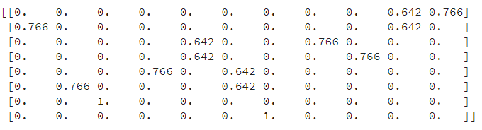
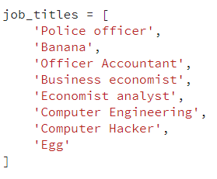
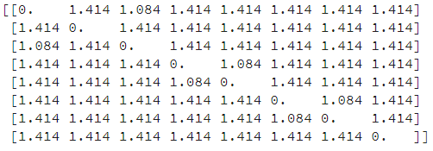
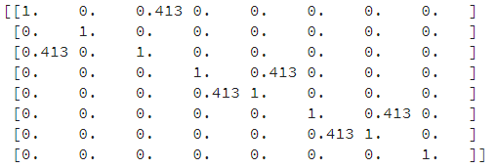
4) Apply K-means to Text Analytics
8 jobs → 4 clusters
TF-IDF matrix
Euclidean distances
Cosine similarity
We can understand that: {1,3}; {4,5}; {6,7}; {2,8}

Slide 33
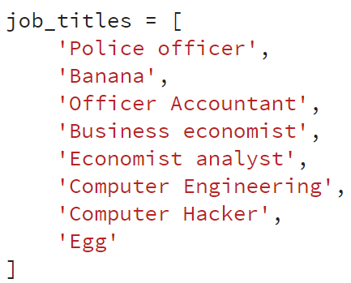
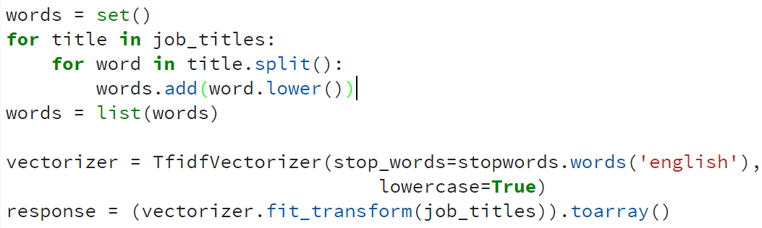
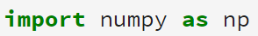
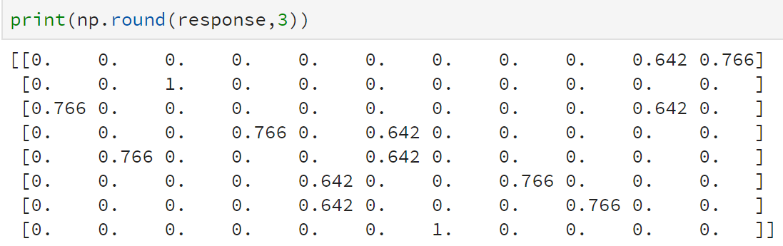
4) Apply K-means to Text Analytics
TF-IDF
matrix

Slide 34
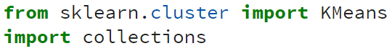
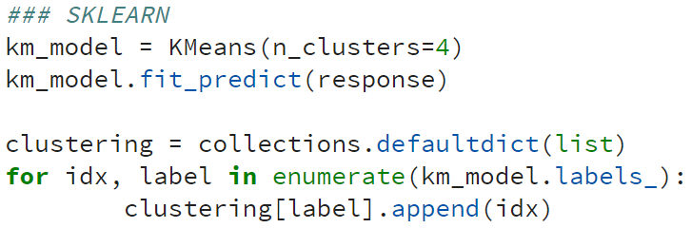
4) Apply K-means to Text Analytics
# Model of the clustering
# Get the
cluster’s number

Slide 35
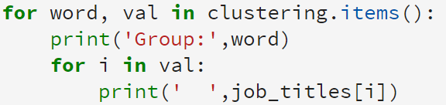
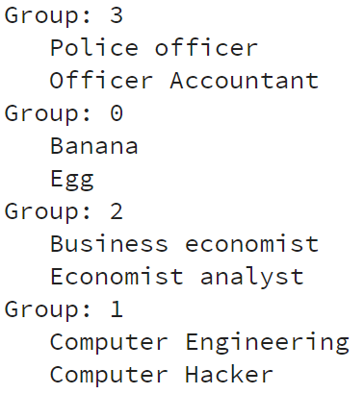
4) Apply K-means to Text Analytics
# Print results

Slide 36
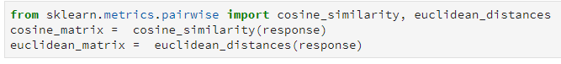
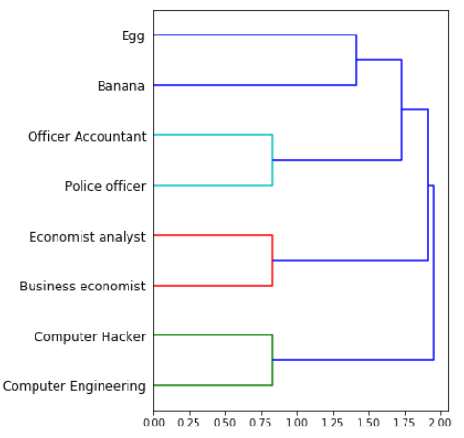
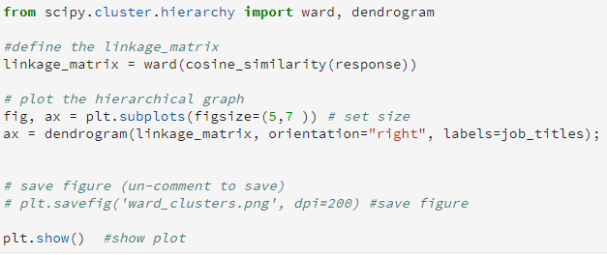
5) Apply Hierarchical model

Slide 37
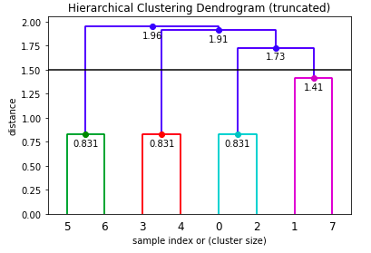
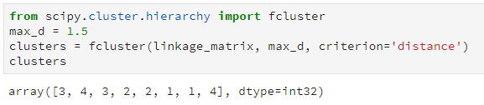
5) Apply Hierarchical model
Retrieve the Clusters
Knowing max_d:
Let's say we determined the max distance with help of a dendrogram, then we can do the following to get the cluster as follows
0
1
2
3
4
5
6
7

Slide 38

5) Apply Hierarchical model
Retrieve the Clusters
Knowing k:
Another way starting from the dendrogram is to determine number of clusters “k=4”.

Slide 39


Summarize
Raw text D1
Text → Vector
Euclidian Distance
Cosine Similarity
Clustering
K-means Clustering
Hierarchical Clustering
<close to centroid>
<dendrogram>

